Slide 1
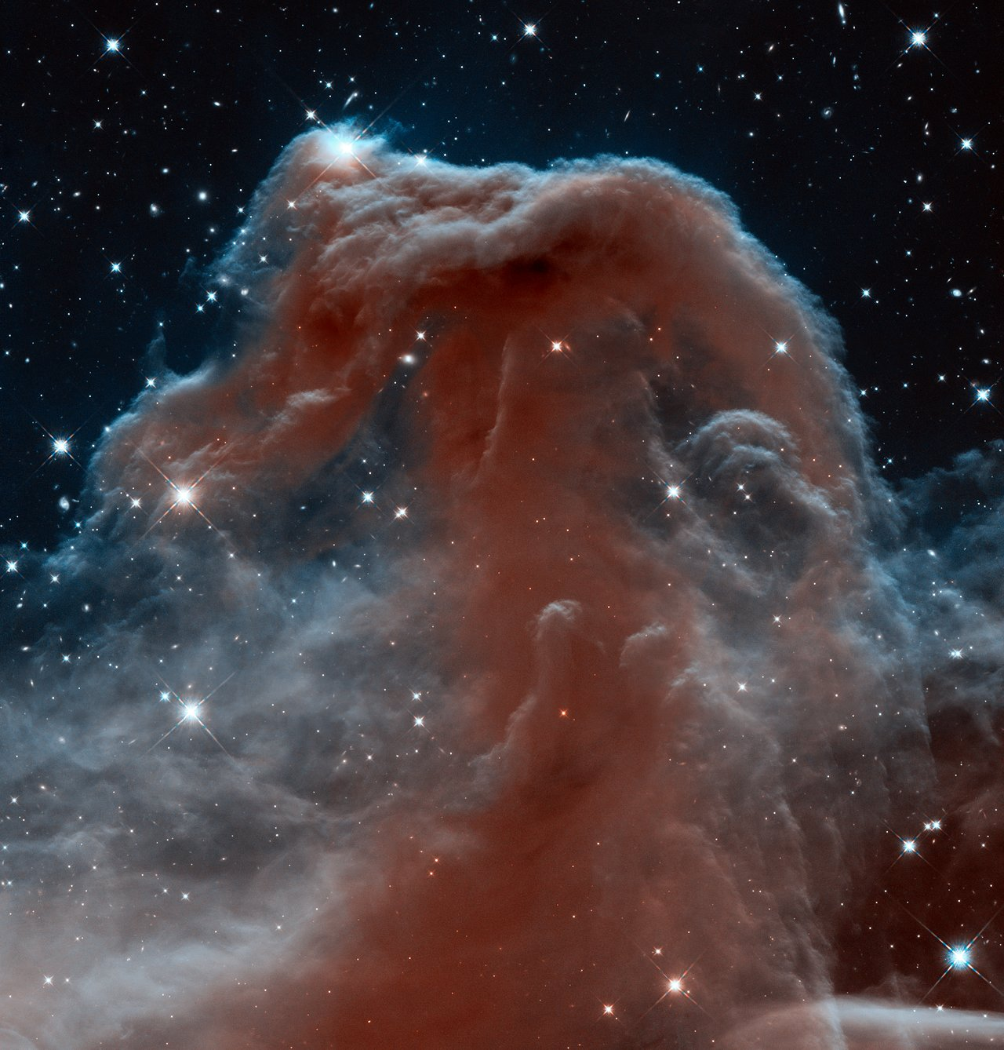

Classifying stars and galaxies using a Classical-Quantum neural network workflow
SAQuTi Internship
07-31 January 2026
Sam Snyman
Host:
IBM Research Africa

Slide 2
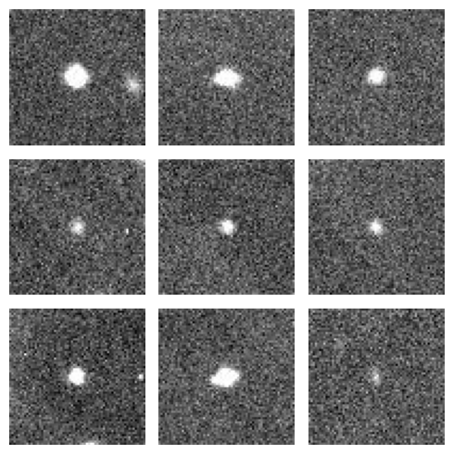
Can you spot the 2 galaxies?
1
2
3
4
5
6
7
8
9

Slide 3
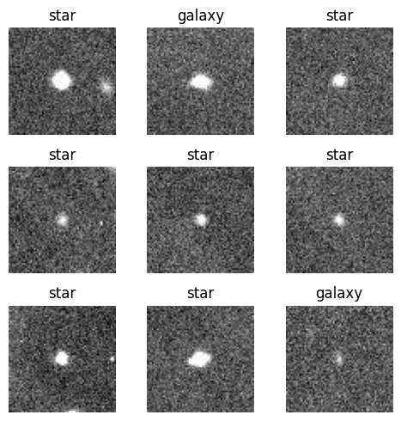
Classifying is difficult. This is why ML is useful
1
2
3
4
5
6
7
8
9

Slide 4
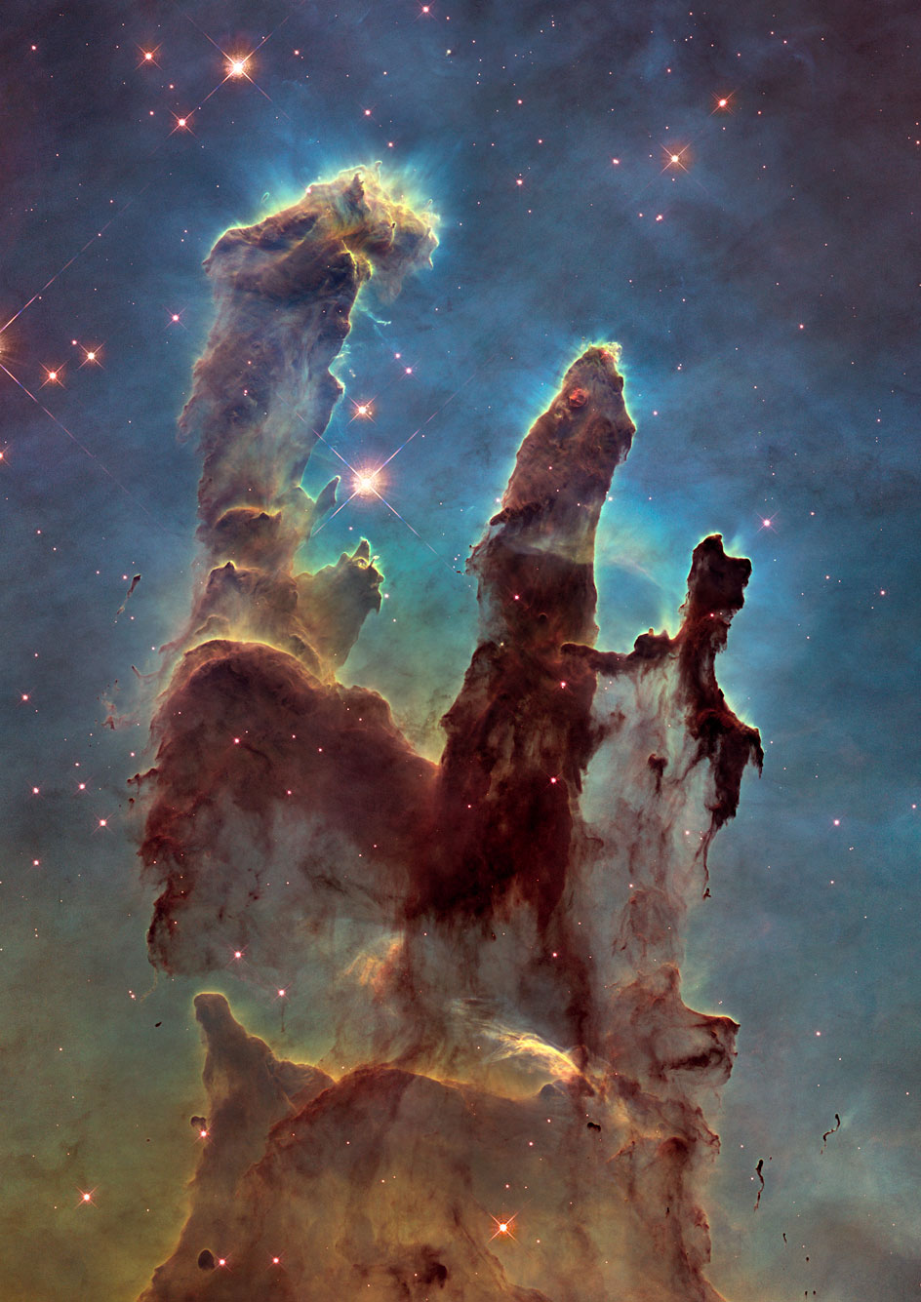
Objectives and hypothesis
Goal: Try to improve classification by incorporating quantum ML methods into the classical workflow.
Why: Classifying celestial bodies is difficult and could be very useful to astronomers.
Hypothesis: Using a hybrid Classical-Quantum ML workflow should allow us to achieve a higher F1-score.
Entangling qubits allows us to express complex feature dependencies that classical methods might not be able to capture efficiently.
But not all datasets have complex feature dependencies to encode, or those features may already be encoded well by classical methods, so a higher F1-score is not guaranteed.

Slide 5
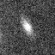
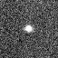
Materials
Data:
Images of stars and galaxies
Captured by a 1.3m telescope in an observatory in India by Divyansh Agrawal:
Additional variations added to data:
Horizontally flipped
Rotated up to 10 degrees
Randomly applied to data to make the model learn to generalize more
64x64 galaxy image
Originally 2k x 2k images of the sky reduced to 64 x 64 cutouts to isolate star or galaxy in image
Originally jpg images that were converted to greyscale (make training faster and discard meaningless features)
3986 images with a 70/15/15 training/validation/testing split
Hardware:
Nvidia 4050 laptop GPU for Pytorch
12th Gen Intel i7 CPU for Qiskit
64x64 star image

Slide 6
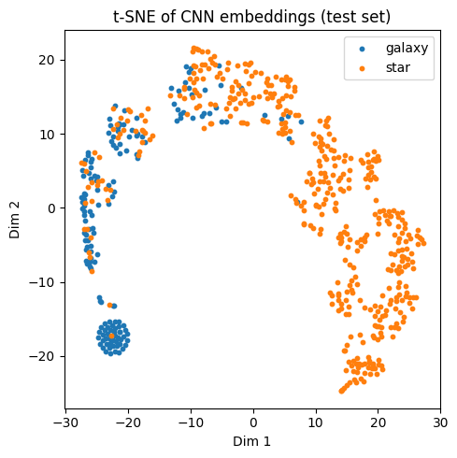
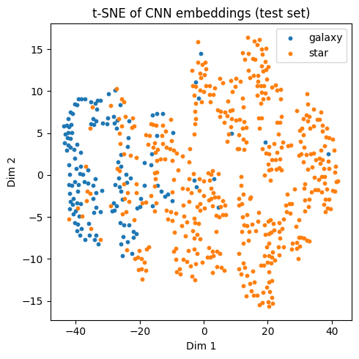
Methods: Classical component
8-dimensional feature embedding
a Convolutional neural network was used to extract feature embeddings out of the images
Final dimension size depended on quantum encoding scheme used
8 - dimensional embedding
* Similar results from 64-dim
128-dimensional embedding
The CNN takes the shape:
Input image (1 × 64 × 64)
→ Conv(32) + ReLU + Pool → (32 × 32 × 32)
→ Conv(64) + ReLU + Pool → (64 × 16 × 16)
→ Conv(128) + ReLU + Pool → (128 × 8 × 8)
→ Flatten (8192)
→ Dense (x-dim embedding)
To evaluate embedding quality these methods were used:
t-SNE graphs
PCA graphs
Linear probing
The CNN was made using Pytorch and was trained using a Nvidia 4050 laptop GPU

Slide 7
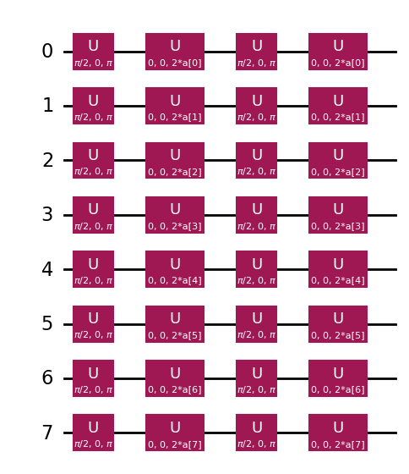
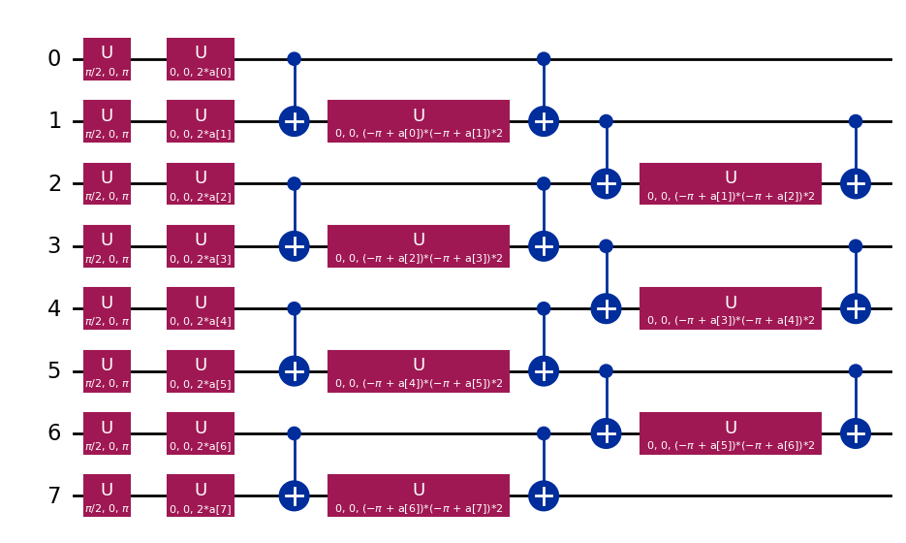
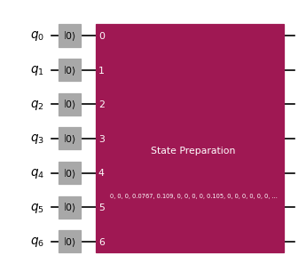
Methods: Quantum component
The feature embeddings are then used as input to a Quantum neural network (Variational Quantum Circuit).
QNN’s consist of:
Feature encoding (encode classical data onto qubits)
Ansatz (circuit block with trainable parameters)
Observable (used to read output)
Pairwise ZZ encoding
Z encoding
Three feature encodings were used:
Z encoding
ZZ encoding
Amplitude encoding
Two approaches to training:
Serial
End-to-end
Amplitude encoding

Slide 8
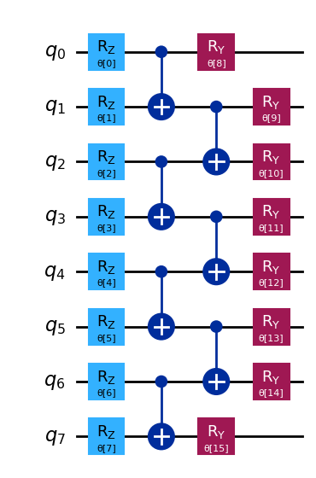
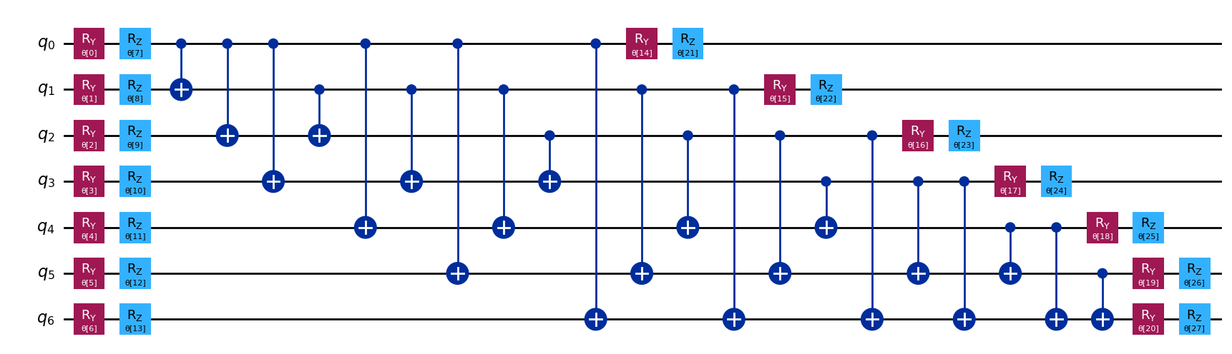
Methods: Quantum component (2)
Two Ansatz were used:
Efficient-Su2
Self-made ansatz
Self-made ansatz
The best results were found using amplitude encoding and the Efficient-Su2 ansatz with full entanglement and 1 rep, training the hybrid model serially
Efficient SU2 ansatz
The QNN was made with Qiskit and trained using a simulator on a CPU

Slide 9
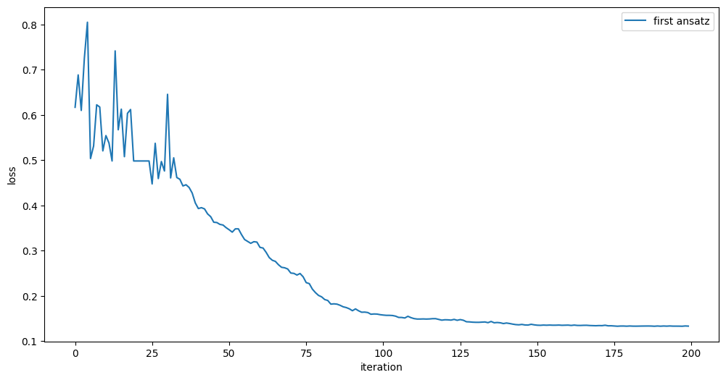
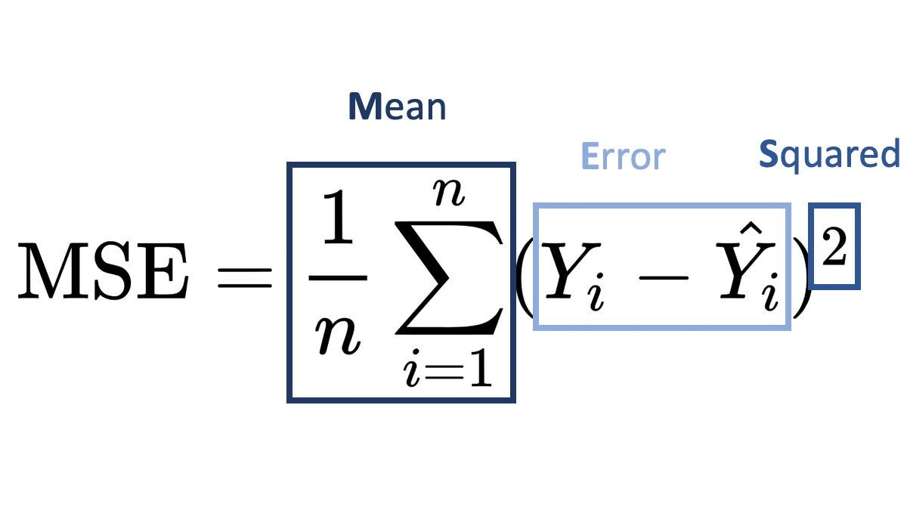
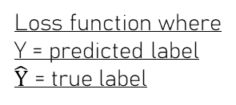
Results
Models were trained until their loss functions converged:
The classical-quantum workflow yielded an F1-score of 0.90
To compare the classical workflow, logistic regression was used on the CNN’s feature embedding, yielding an F1-score of 0.93
Loss over iterations of amplitude encoding method
Loss function where
Y = predicted label
$\hat{Y}$ = true label

Slide 10
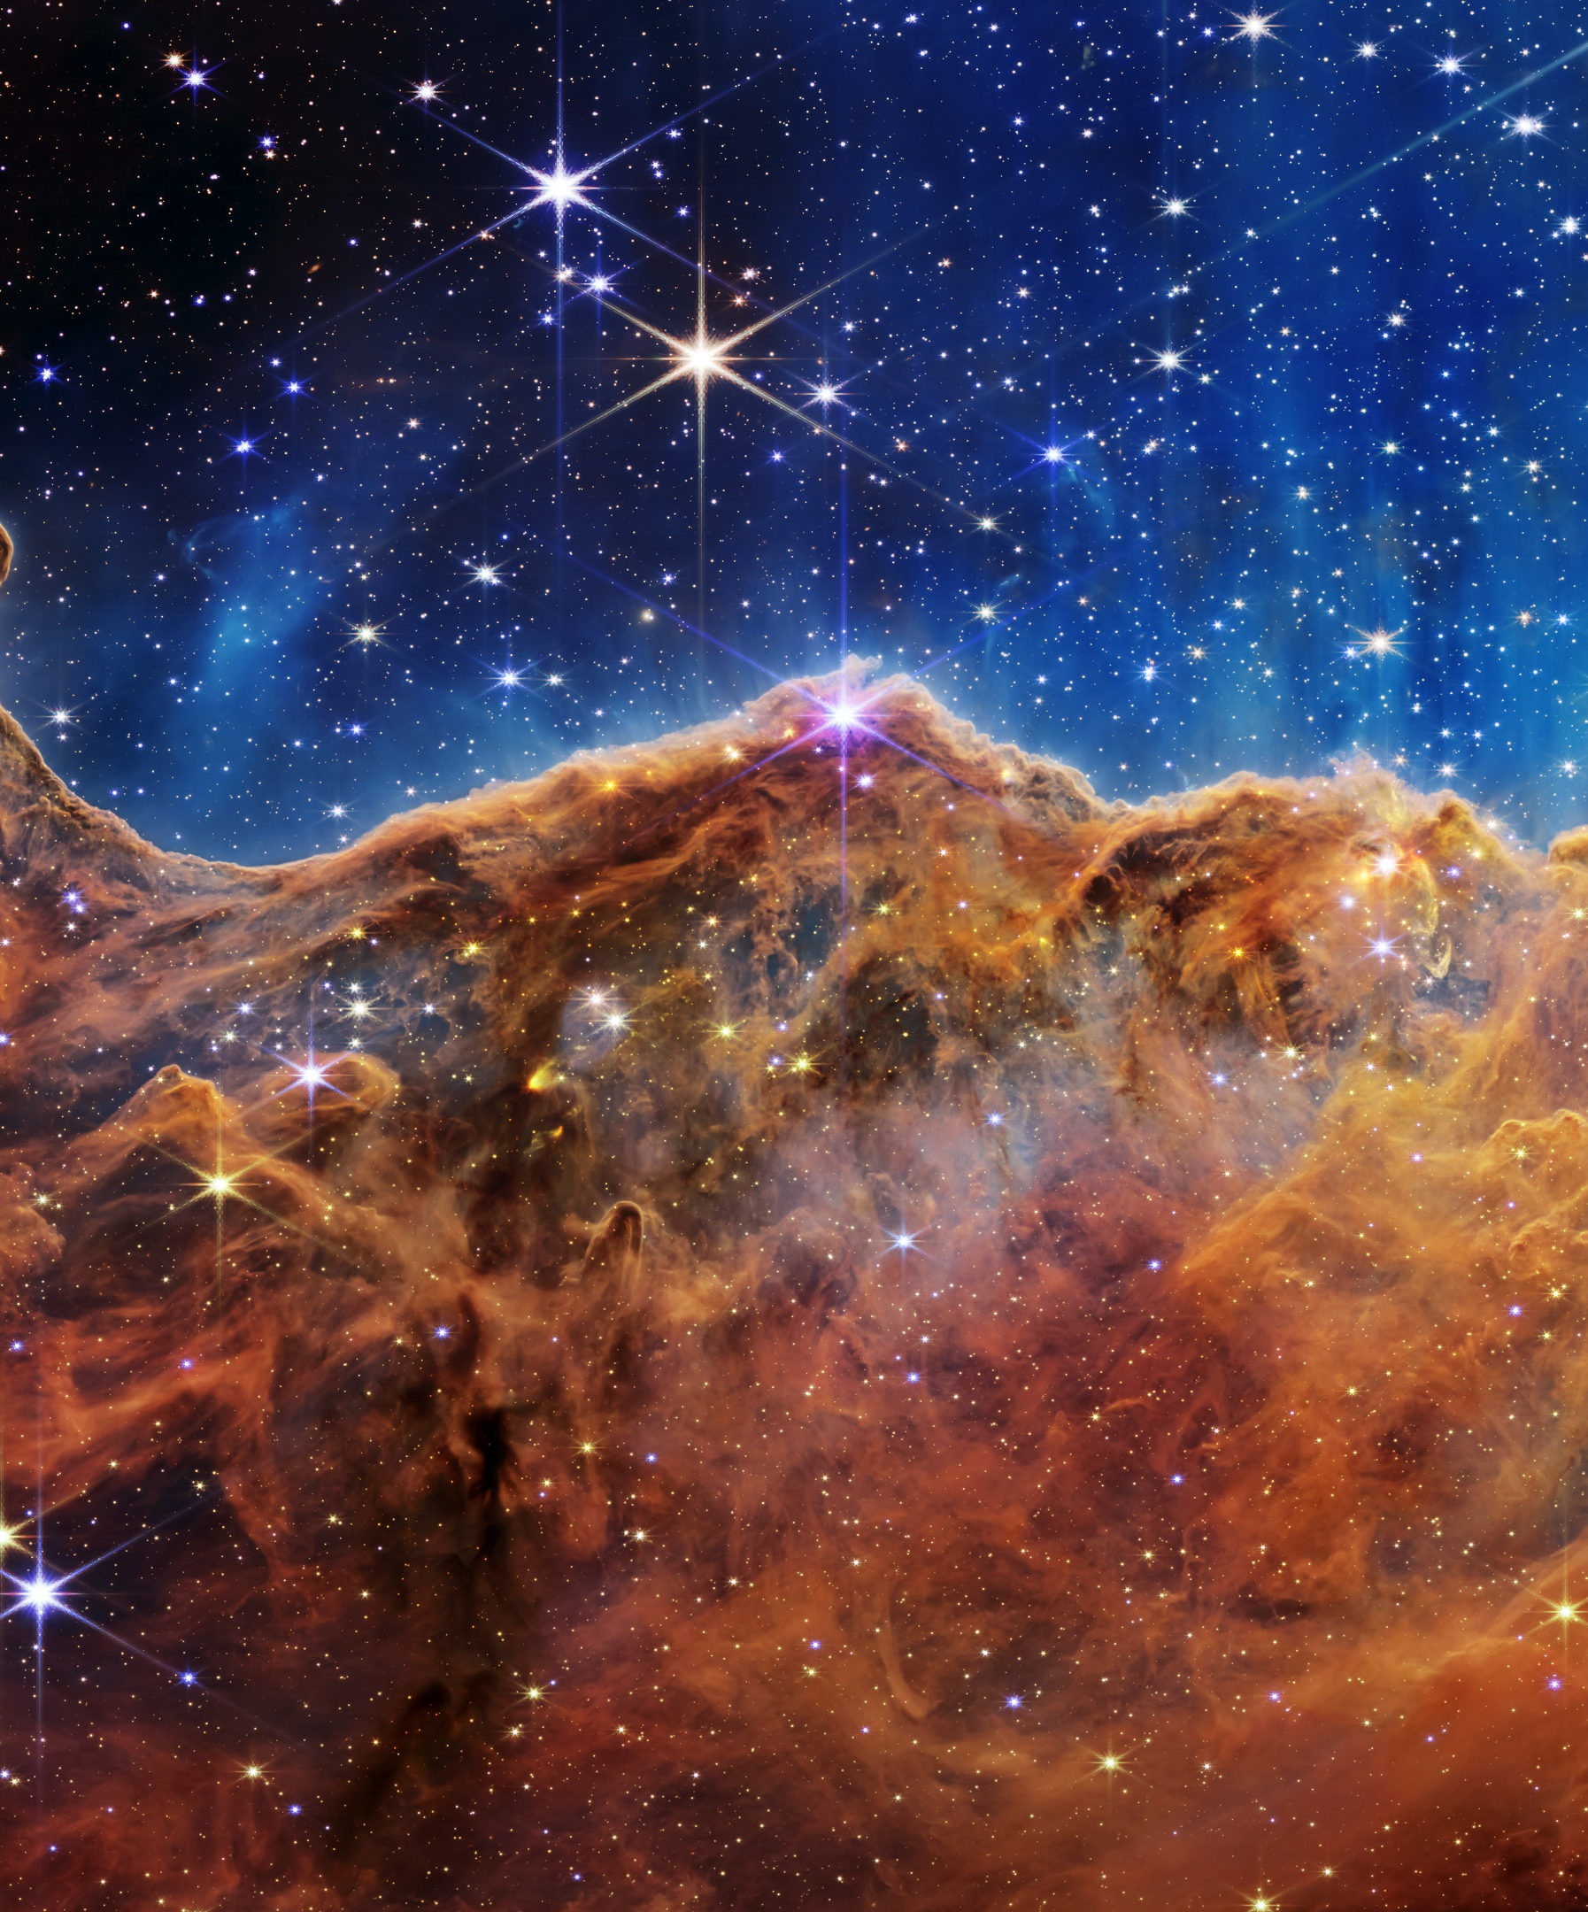
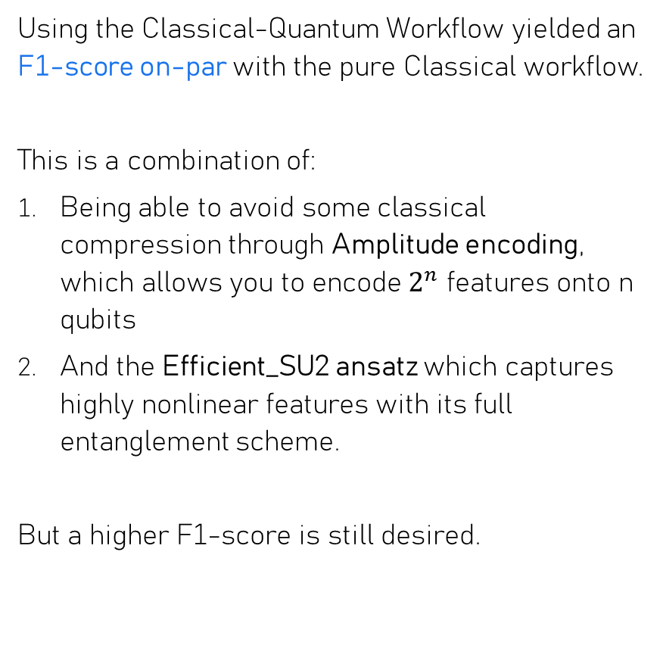
Discussion
Using the Classical-Quantum Workflow yielded an F1-score on-par with the pure Classical workflow.
This is a combination of:
Being able to avoid some classical compression through Amplitude encoding, which allows you to encode $2^{n}$ features onto n qubits
And the Efficient_SU2 ansatz which captures highly nonlinear features with its full entanglement scheme.
But a higher F1-score is still desired.

Slide 11
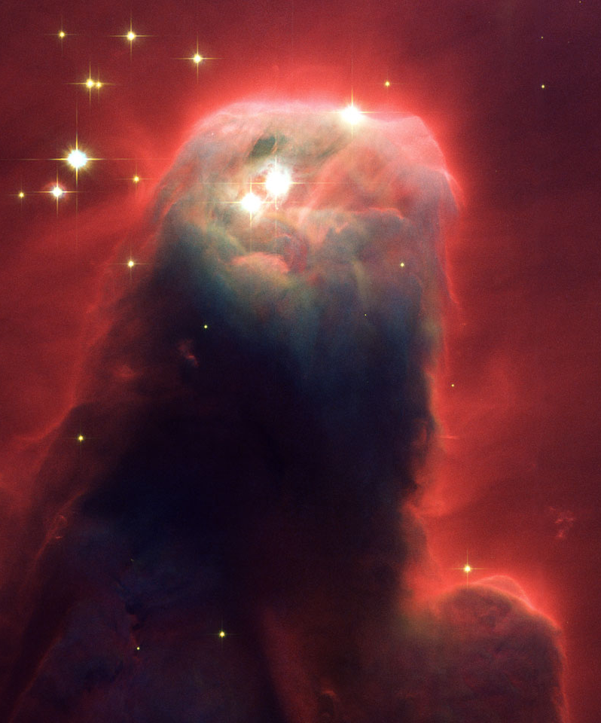
Discussion Future work
There are directions to look for a higher F1-score:
1. Use more complex data
The images are fairly simple (centred white spot)
In the future, explore datasets that are more likely to be improved by Quantum ML
E.g. Datasets with highly non-linear or high-order feature interactions (more complex celestial body datasets)
Could develop a model that determines whether a dataset is suitable to be improved by QML
2. Hardware and circuit improvements
Can’t take the entire image into a QNN with hardware accessible in this research. Too many qubits would be required; needs to be compressed first.
This limits expressivity. Might miss features that had complex dependencies.
Experimenting with simulators on GPU’s or higher access plans to quantum computers may lead to a higher F1-score.

Slide 12
Conclusion and Acknowledgements
That covers my research for this internship. Thank you!
The IBM Research Africa team for their guidance
Dataset: https://www.kaggle.com/datasets/divyansh22/dummy-astronomy-data
QML methods: https://quantum.cloud.ibm.com/learning/en/courses/quantum-machine-learning
Hubble telescope pictures: https://esahubble.org/

